Slide 1
Unit - 3
Function

Slide 2
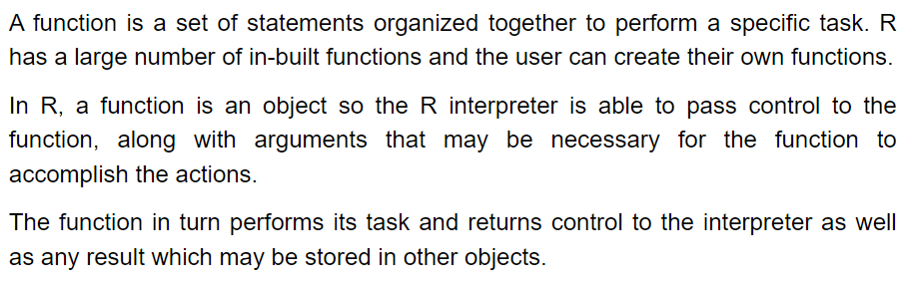
Function

Slide 3
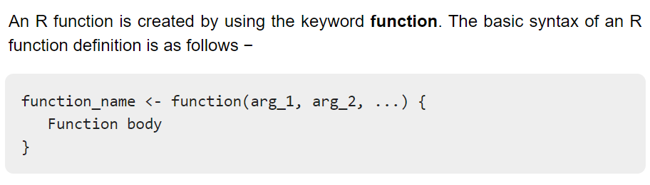

Slide 4
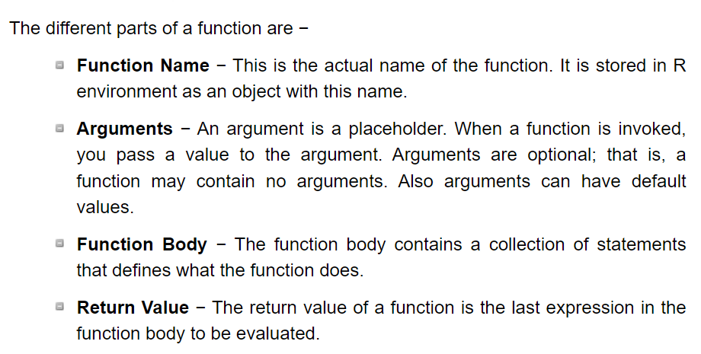

Slide 5
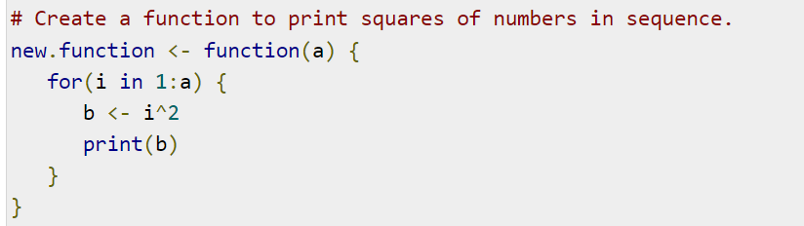
User Defined Function: Creating a function

Slide 6
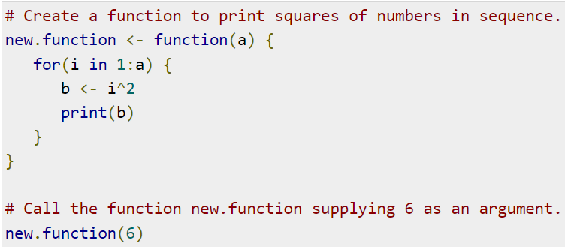
User Defined Function: Calling a function

Slide 7
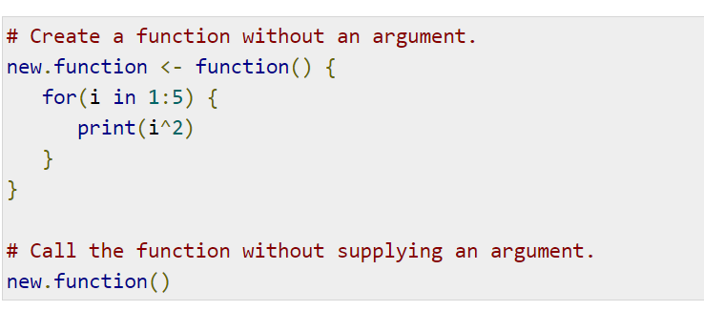
Function without an argument

Slide 8
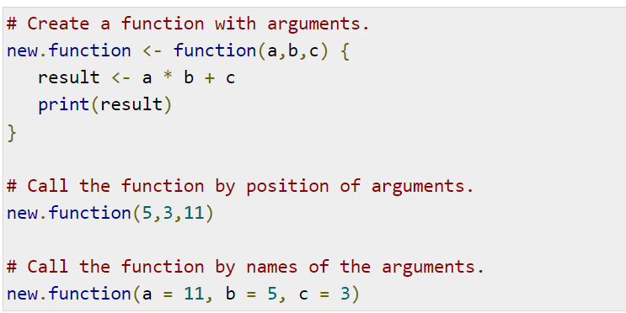
Calling a Function with Argument Values (by position and by name)

Slide 9
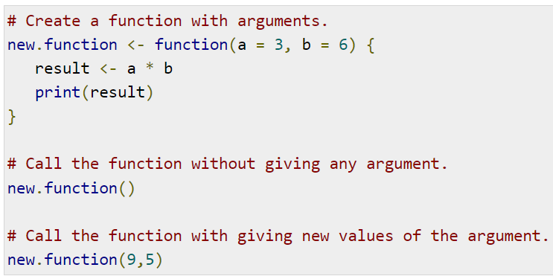
Calling a Function with Default Argument

Slide 10
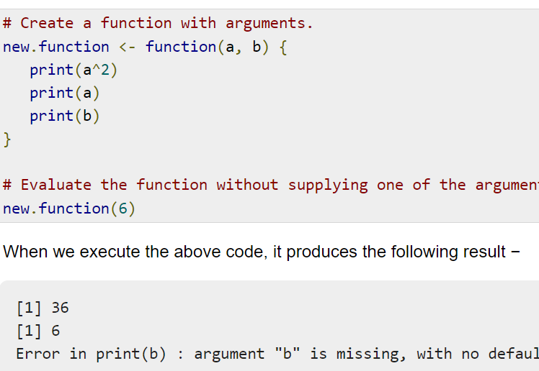
Lazy Evaluation of Function

Slide 11
Examples
Write a program to check whether a number is even or odd using function.
Write a program to find the area of a circle using function.
Write a program to find the area and perimeter of a rectangle.

